Slide 1
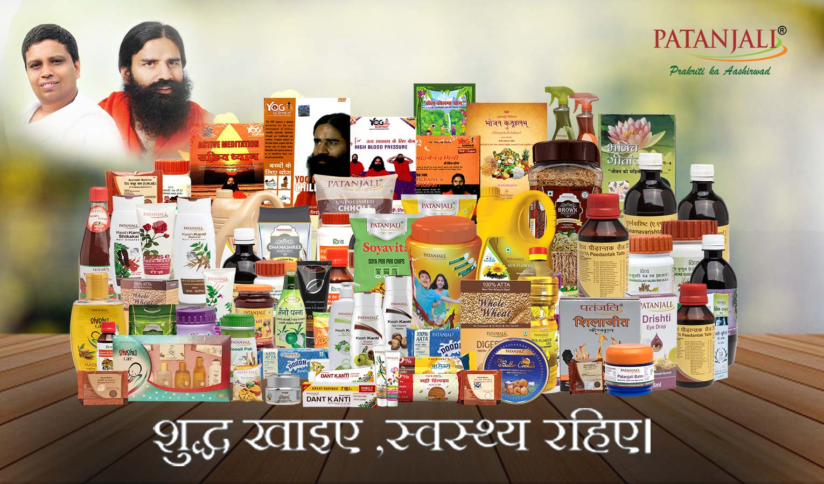



Retail-O-Mania
Team SORTED
A Retail Strategy Competition
Devesh Sinha Mohit Kiradoo Kajal Gupta
T. A. Pai Management Institute

Slide 2
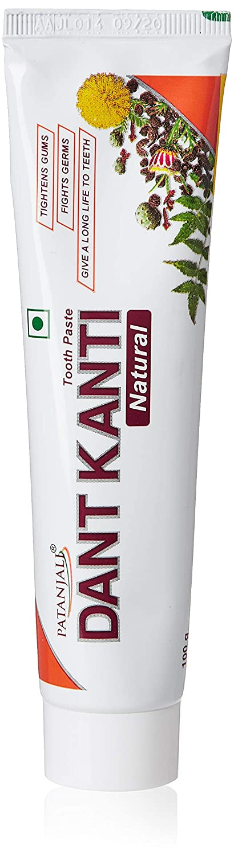
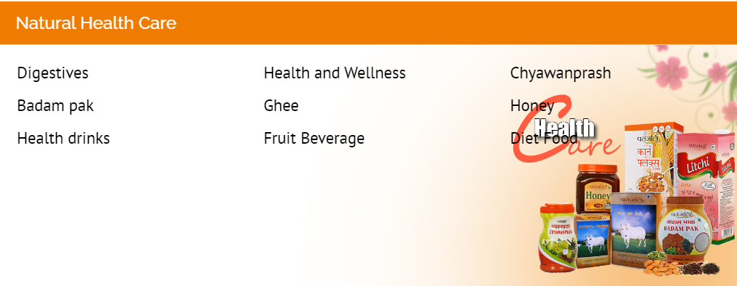
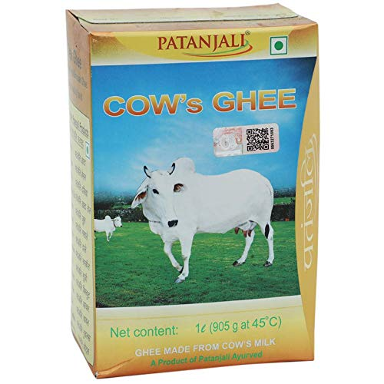
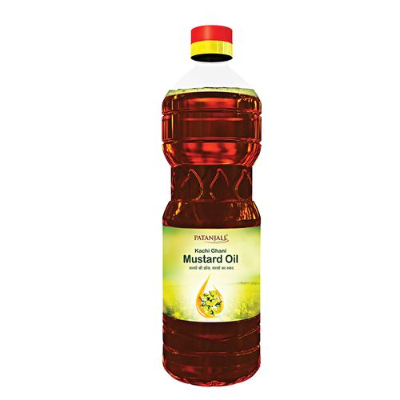
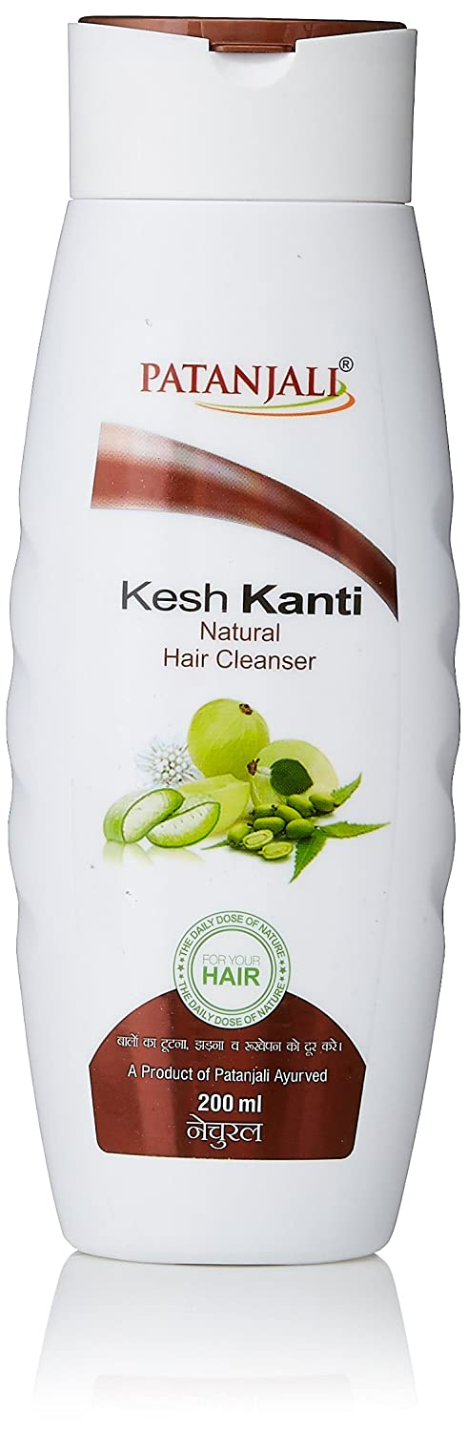
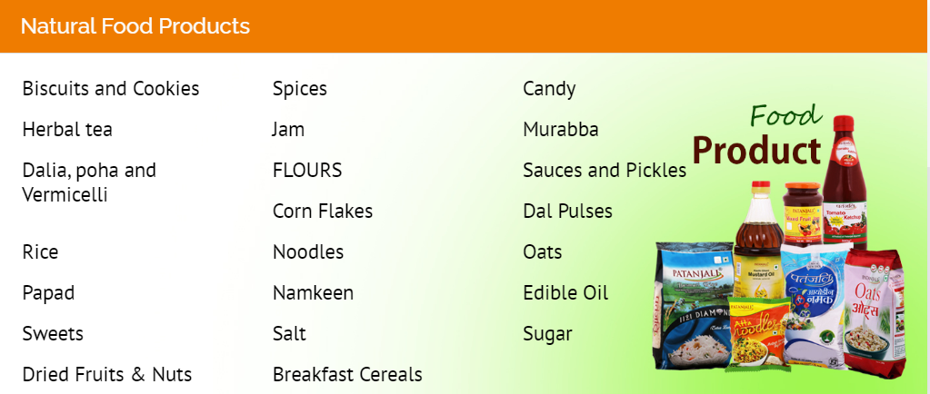

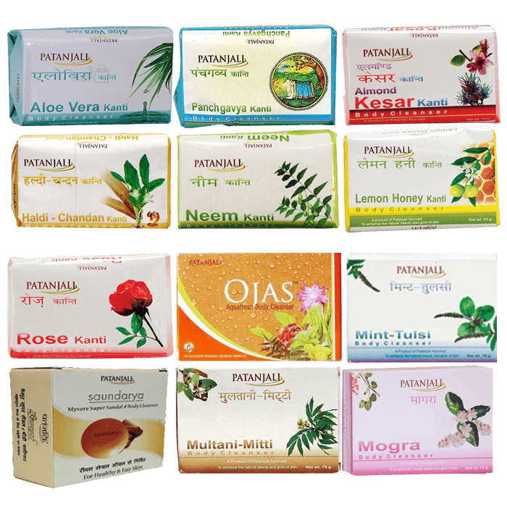
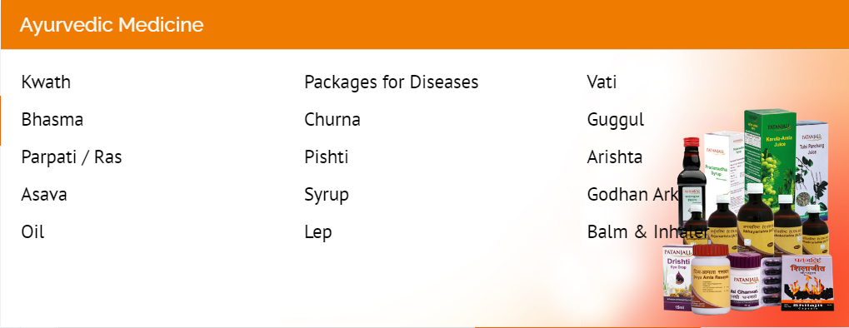
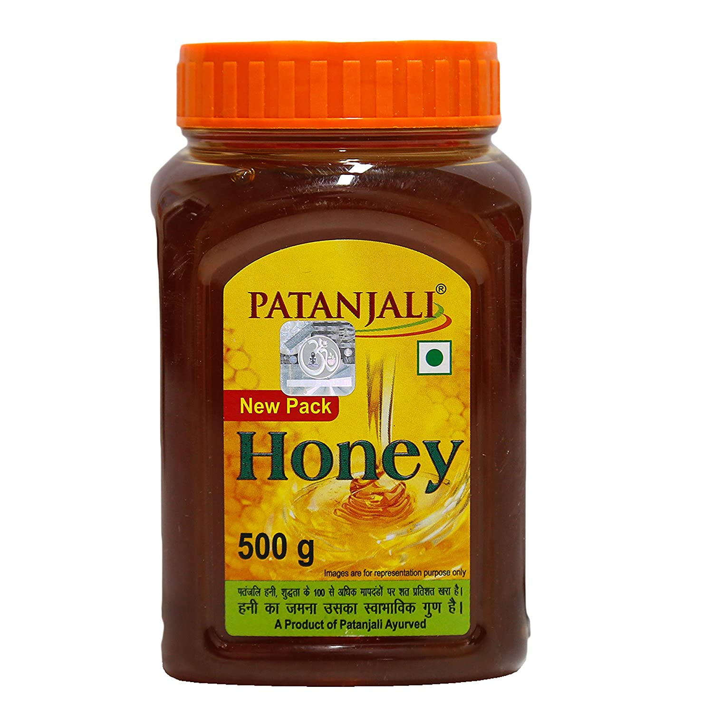
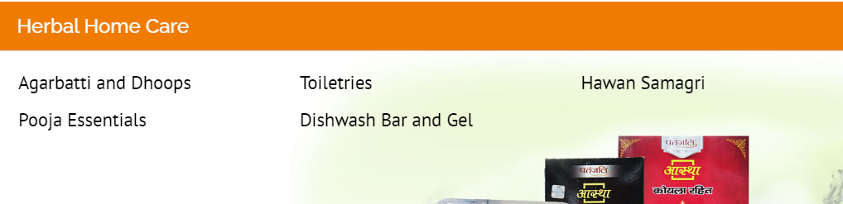
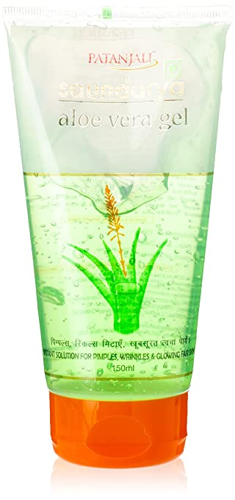
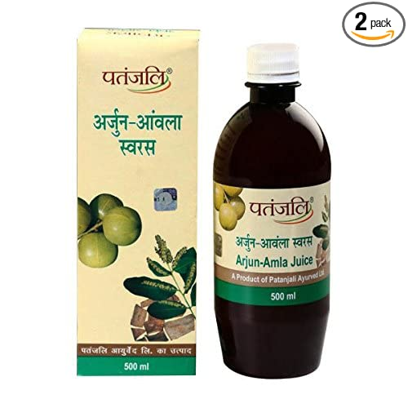
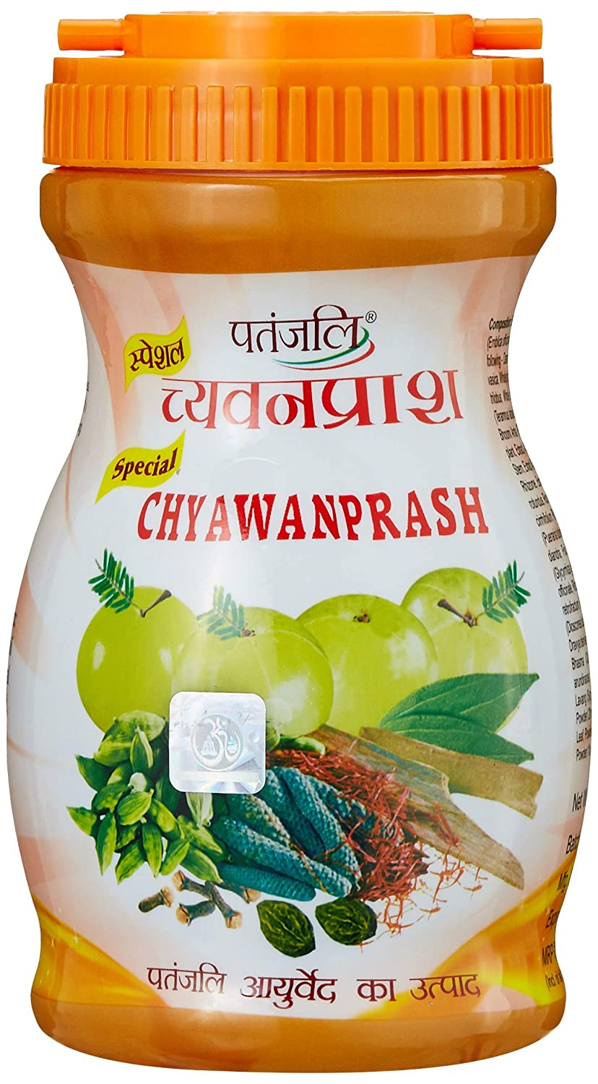
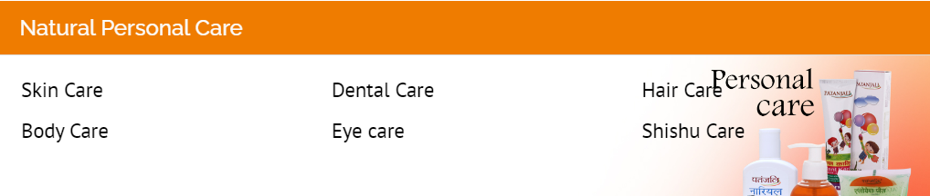
Product Mix
Competitors & Perception
Mega Store & Pain points
Store Layout
Planogram
Current In-Store Marketing
Proposed In-Store Marketing
Proposed In-Store Engagement
Patanjali Product Mix (Source: Patanjali Website)
Top 10 products in the portfolio
Product Sales Share as of 2021
Why Patanjali ??
Prices of Patanjali products are 10%-30% lesser
Mantra of natural and no chemicals gained mouth publicity to a great extent
“Swadeshi” brand, plays a major role
Plant operating costs are very low
High brand loyalty
Availability at different retail channels
Like any other FMCG Patanjali too has few star products which drives 56% of the total sales. The product mix understanding is necessary to strategize a comprehensive retail channel.

Slide 3
Product Mix
Competitors & Perception
Mega Store & Pain points
Store Layout
Planogram
Current In-Store Marketing
Proposed In-Store Marketing
Proposed In-Store Engagement
Category | Patanjali’s Best Products | Competitors Brand/Products | Patanjali’s Stand
Natural Health Care | Ghee, Chyawanprash and Honey | Ghee: Amul, Sun Grow, Sri Sir, Aashirvaad. Chyawanprash: Dabur, Zandu, Ved Prash. Honey: Dabur, Himalaya, Saffola, Indigenous | Dominating with Ghee, Chyawanprash and Honey
Natural Food Products | Herbal Tea, Spices, Biscuits, Flours, Pulses, Edible Oil, Corn Flakes | Tea: Tetley, TATA. Spices: MDH, Everest, Flours: Aashirvaad, Corn Flakes: Kellogg’s. | Spices and Biscuits are most performing
Ayurvedic Medicine | Kwath, Churna, Syrup, Balm, Guggul, Kaadha, Asava, Lep, Vati, | Dabur, Badiyanath, Zandu, Hamdard, Emami | Dominating in ayurvedic medicines
Herbal Home Care | Dishwash Bar, Agarbatti, Dhoops | Bar: Vim, Exo, Nip. Agarbatti: ITC | Dishwash bars are on top
Natural Personal Care | Aloe vera gel, Dantkranti, Keshkanti oil, Facewash, Bath Soap | Wow, Mamaearth, Kamaayurveda, Forest Essentials, Colgate, Himalaya, Emami | Aloe vera gel is leading, DantKanti disrupted the market, Facewash market declined due to new players
Brand Perception, Satisfaction Level and Attributes of consumers towards Patanjali. Sample Size: 200, Location: Udupi/Manipal. Mode: Google Forms & Depth Interviews

Slide 4
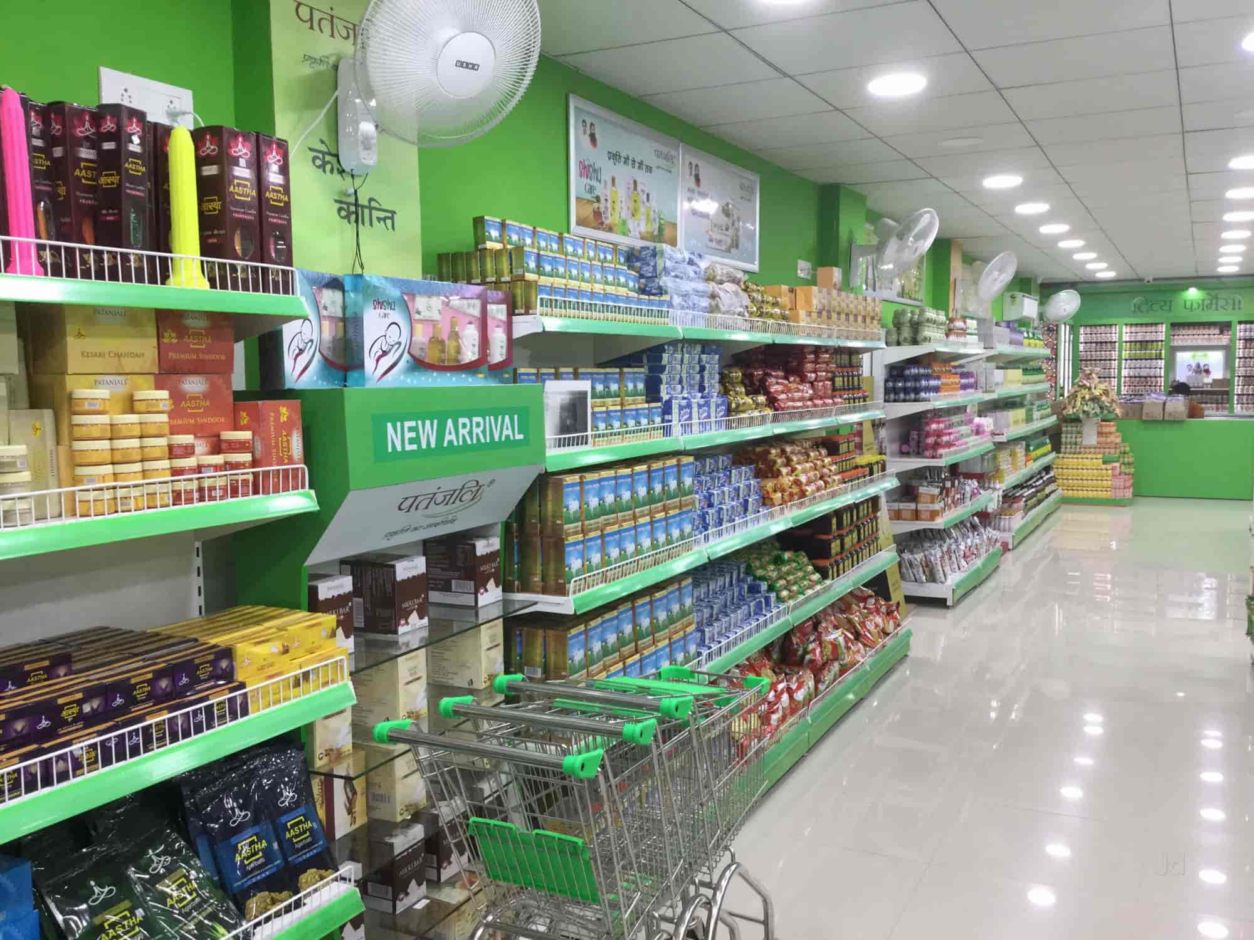

Product Mix
Competitors & Perception
Mega Store & Pain points
Store Layout
Planogram
Current In-Store Marketing
Proposed In-Store Marketing
Proposed In-Store Engagement
Reference Point: Patanjali Mega Stores
Reasons:
Easy to implement in-store marketing, Planogram and Salesperson engagement
Brand doesn’t have the say when it comes to modern trade and other retailers
Highly popular in urban cities where the 3 mentioned pillars work the best
Patanjali Mega Stores overview:
Total 286 Patanjali megastores
Minimum 2000 Sq. Ft space is required
An Initial investment of Rs 1 Cr is required
Only be placed in city’s prime locations
Megastores shall be at least 2.5 Kms from current Mega Stores
Depth Interview: Analysis of Owner Pain Points
Visual Merchandising SOPs are not clear. Store staff do shelf placement according to them
Customer base is not increasing due to new and fancy competitors. Most sales is from regular customers that too is declining slowly
The POP materials and In Store marketing items come from Haridwar office but are usually old and arrive late
Store staff product training is not clear by the company. They learn mostly from the co-workers
The In-House Vaidh (Doctor) is mostly unavailable because it’s for free and he has his own personal chamber
Mr. Suresh Agarwal
Proprietor: Patanjali Megastore, Lake Town, Kolkata
Patanjali can only gain the customer loyalty back if they shift a bit ahead from their old school methods which are now ineffective due to change in consumer buying behaviour and Intellect

Slide 5
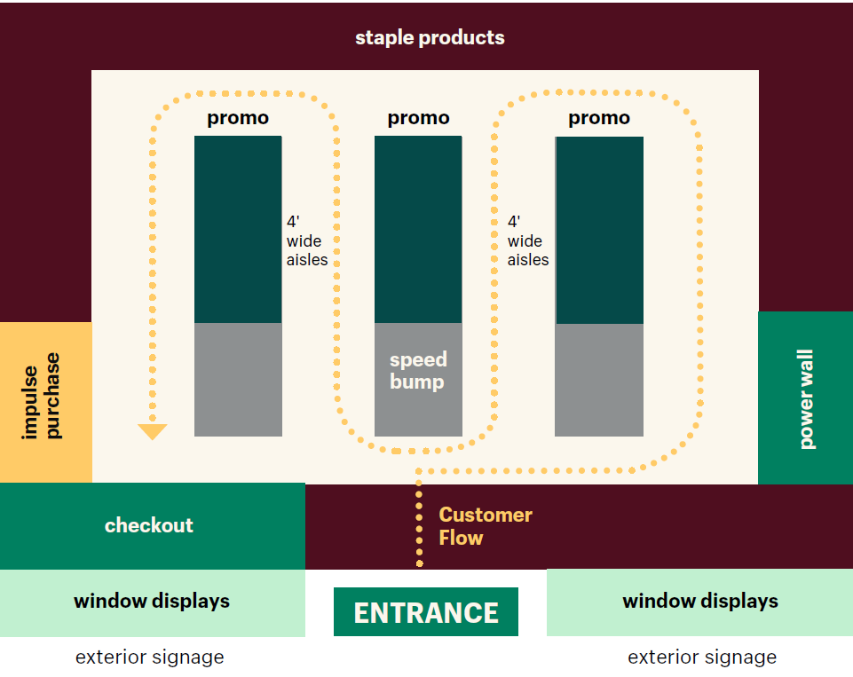




Product Mix
Competitors & Perception
Mega Store & Pain points
Store Layout
Planogram
Current In-Store Marketing
Proposed In-Store Marketing
Proposed In-Store Engagement
Suggested Store Layout for best Planogram Planning
Grid Store Layout
The grid maximizes product display and minimizes white space. This layout is all about product, product, product.
Best for: Convenience stores, pharmacies, and grocery stores.
Real-world example: Walmart
Benefits of Customer Journey Mapping: (Based on secondary research by Shopify)
Generally, the buyers move from right to left in an anticlockwise fashion hence Powerwall needs to be there right at the start of the journey
Checkouts have the highest chance of impulse purchases, hence products like ready to eat food, drinks etc. increase the upselling
Different Categories of Buyers
Grab ‘n Go Buyers: Less time & quick selection
Discovery Buyers: More time, explore the entire store
Considered Buyers: Need smaller assortment to avoid fuss
Impulsive Buyers: Think less & buy more than the desired
According to HBR - https://hbr.org/2021/05/whats-your-customers-purpose understanding of customer purpose is an important understanding for shelf placement strategy

Slide 6
Product Mix
Competitors & Perception
Mega Store & Pain points
Store Layout
Planogram
Current In-Store Marketing
Proposed In-Store Marketing
Proposed In-Store Engagement
Level Wise Placement SOPs: As discussed with one of the Patanjali’s Mega Store Owner. There are no shelf level guidelines for product placement been provided by the company. We propose level-wise placement strategy based on store data to be implemented
Level | Brief | Impact | Patanjali Product
Lower Shelves | For Slow moving products and kids | Higher chances of kids picking up their choices and parents have a sight on the slow-moving products while restricting them | Kids: Nutrela Superfood, PowerVita, Immunity bar Slow Moving: Patanjali Noodles, Biscuits etc
Bottom Shelf | Bottom shelf is for heavy products | It is easier for the customers to life them from the bottom shelf and place in the shopping bucket | 5kg Atta, Oil can, 5kg Ghee, Diapers jumbo pack etc
Eye Level | 35% greater attention compared to other levels (medium.com) “Eye level is the Buy Level” | Products with high margins, attractive packaging and most sold to be placed here | Ghee, DantKanti, Chyawanprash etc
Top Shelf | New products, Premium products to be placed here | Higher status bias, close to the eye level shelf | Latest products (Ex. Pickle),
Other proposals for shelf placement:
Impact on Stakeholders
Spreading high traffic products across the store
Customers are exposed to all the inventory in search of their need
Ghee, DantKanti, Soaps etc at the back and near the slow moving, impulsive (protein bar, juices) at the bill desk etc
Complementary Products adjacency
Complementary products to be placed adjacent to each other which increases cross selling
For example: Patanjali Cow Milk and Corn Flakes, Herbal Tea and Wheat Biscuits, DantKanti and Toothbrush etc
Customers: Increased customer experience & organized shopping
Company: Higher sales, Unanimity, Better tracking
Collaborators (Franchise): Better instructions, Higher ROI
Image recognition using AI through CCTV cameras for planogram - https://itrexgroup.com/blog/image-recognition-in-retail-applications-implementation-tips/# But feasibility is the question.

Slide 7
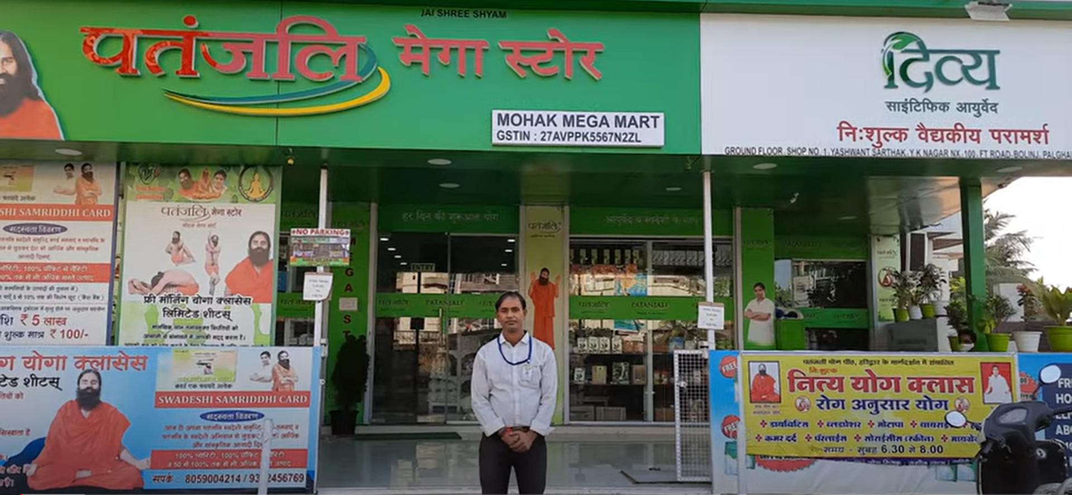
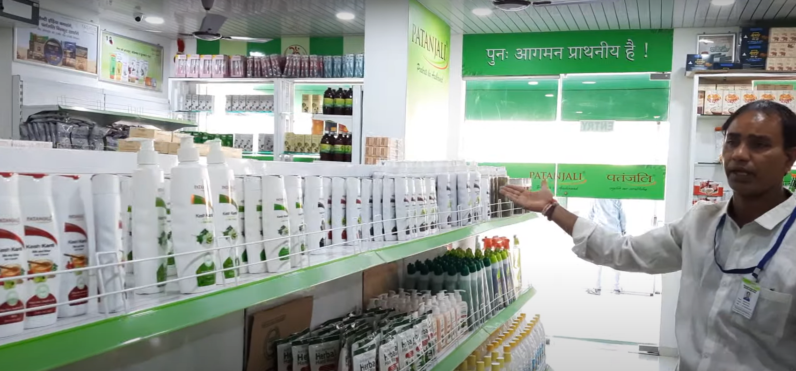
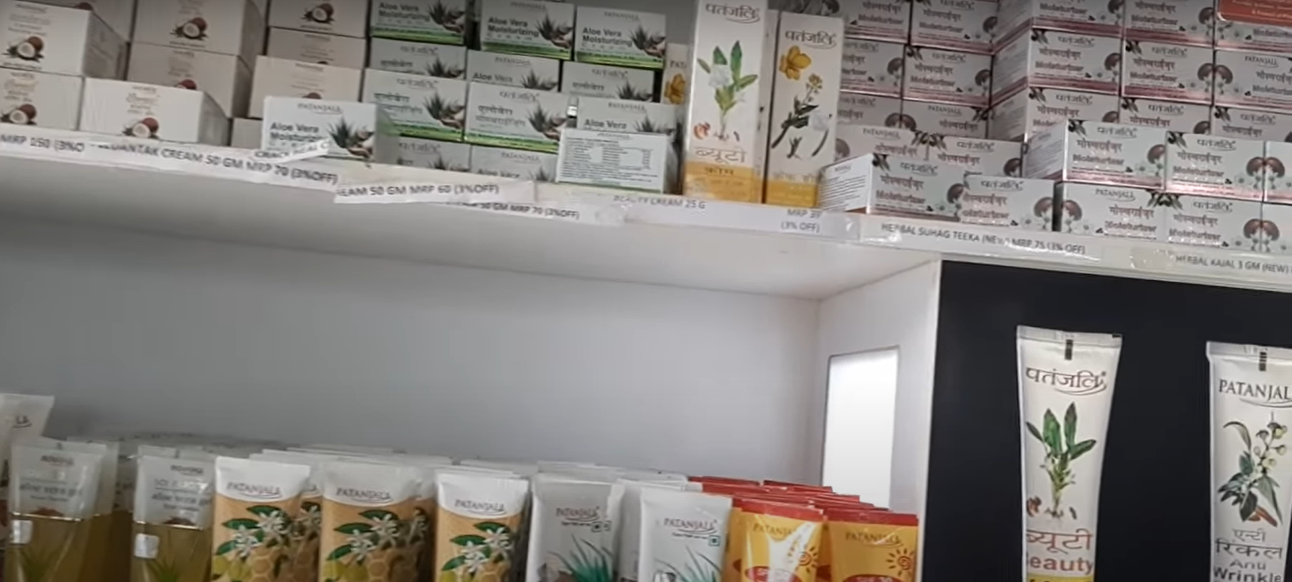
Product Mix
Competitors & Perception
Mega Store & Pain points
Store Layout
Planogram
Current In-Store Marketing
Proposed In-Store Marketing
Proposed In-Store Engagement
Current In-store marketing activities and related issues in the Mega Stores.
Secondary research: Mega Store Virtual Tour : https://www.youtube.com/watch?v=pxXq87Zt40U, https://www.youtube.com/watch?v=yjJEpysE_9g&t=10s
Too much of personal branding (more than 20 cut-outs/photos of Baba Ramdev and Balakrishna
Consumer Perception (more than one option could be chosen)
45% of the respondents agrees that controversies related to these two affect their visit to the store
37% of the respondents finds it as a distraction while shopping (personal bias may be)
19% of the respondents shop from Patanjali only because of Baba Ramdev and his wisdom
15% of the respondents does not care about these cut-outs they are loyal to the products
Use of Hindi for customer experience enhancement and product descriptions PAN India
Consumer Perception (more than one option could be chosen)
74% of the respondents (In South India) believes use of regional languages would attract more people
24% of the respondents finds Patanjali “Hindu Centric” (A negative perception)
12% of the respondents does not care about the language much. They are product loyal
Poor Product Explainers (Less visibility, not maintained)
Consumer Perception (more than one option could be chosen)
66% of the respondents prefer to read product explainers if the product is unknown or new
54% of the respondents prefer to read price on the product explainers itself
10% of the respondents does not care about product explainers while buying from Patanjali
Patanjali should focus more on competitive in-store marketing activities that are relevant for modern trade formats now and focus less on personal branding of Baba Ramdev in Tier 1 cities

Slide 8
Product Mix
Competitors & Perception
Mega Store & Pain points
Store Layout
Planogram
Current In-Store Marketing
Proposed In-Store Marketing
Proposed In-Store Engagement
Marketing Objective | Proposed Plan
Existing Customer Retention | Tech Enabled Loyalty Program and benefits
Existing Customer Retention | Tech Enabled combo offers, and deals based on previous purchases
Existing Customer Retention | Free & fast Home Delivery
New Customer Acquisition | Customer Referral Program
New Customer Acquisition | Creative Signage and Well-Lit Store façade
Cross Selling | Creative POP items with Call to Action
Expected Benefits
(sources are linked to appendix)
A 5% increase in customer retention increases profits by 25% to 95%¹
According to Salesforce report, 51% of the customers expect their loyal brand to personalize deals for them²
1 in 10 households buying groceries online is placing over 10 orders a month via Quick Commerce apps³
According to a survey by Harvard referred customers are 36% more likely to buy than other customers⁴
According to a report by Indianretailer.com an excellent store façade and signage improves attention rate by 40%⁵
Important KPIs to measure the effectiveness of marketing activities: Sales Per Square Foot, GMROI, ATV, Customer Retention Rate, Conversion Rates, Foot Traffic, Inventory Turnover Ratio

Slide 9










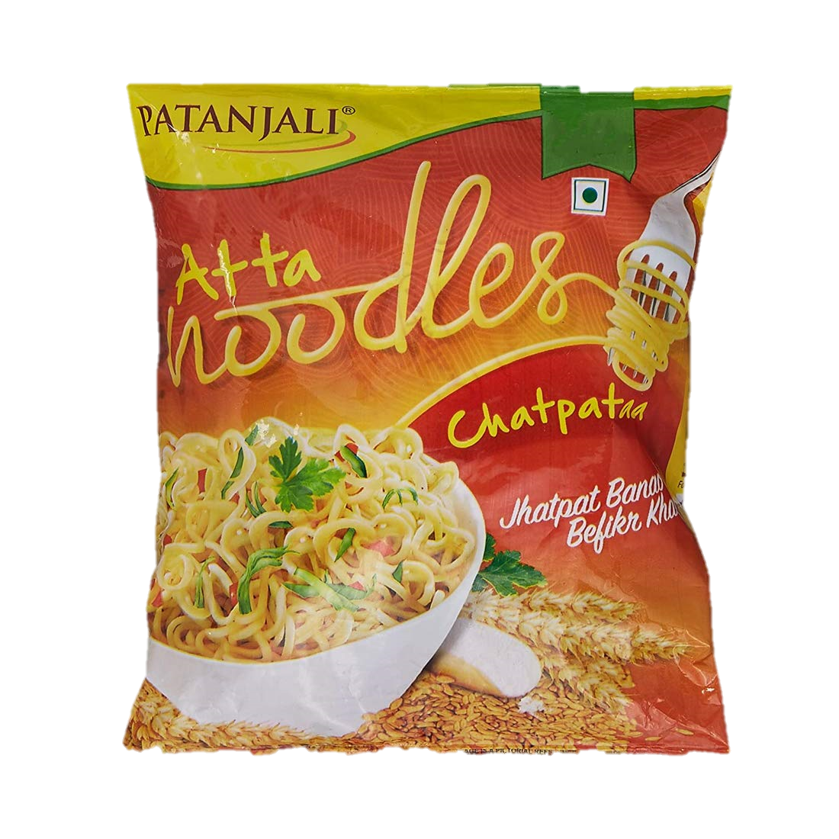
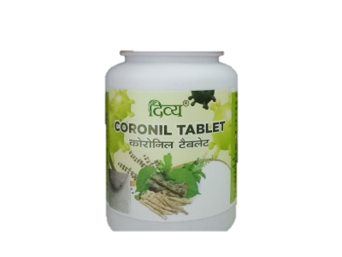
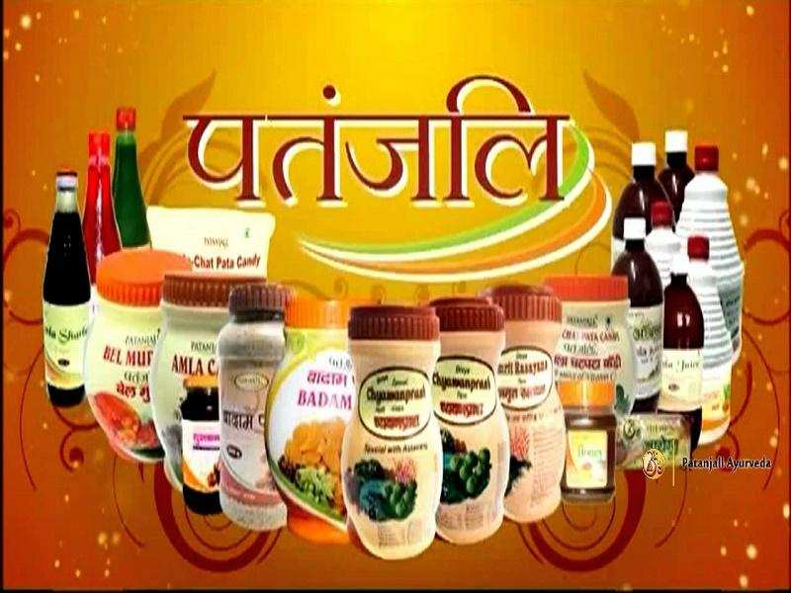



Product Mix
Competitors & Perception
Mega Store & Pain points
Store Layout
Planogram
Current In-Store Marketing
Proposed In-Store Marketing
Proposed In-Store Engagement
Must have skills for salesperson
Store Manager
VM Expert
Ayurved Expert
Operations Staff
Thorough product knowledge, product benefits, ingredients, new products
Pitch for Swadeshi Samridhi Card:
Explaining the benefits of the card
Explaining the redemption process
Enthusiasm and interest about Ayurveda and a good advocate of the same
Assisting the senior citizens at store:
Brand values of Patanjali supports Indian Culture
Senior Citizens spread wide word of mouth
Engagement
High
User engagement by explaining products digitally:
A Television to be placed in all the mega stores
Videos of salesperson explaining product benefits
Low
Movement
Product Samples/Demonstrations:
Engaging with customers through sample testing and demonstrations of new and complex products
High

Slide 10
Appendix
A 5% increase in customer retention increases profits by 25% to 95% (Source: https://hbr.org/2021/10/how-to-make-your-loyalty-program-pay-off )
According to Salesforce report, 51% of the customers expect their loyal brand to personalize deals for them (https://www.salesforce.com/resources/articles/retail-loyalty-programs/)
1 in 10 households buying groceries online is placing over 10 orders a month via Quick Commerce apps (https://www.localcircles.com/a/press/page/online-grocery-survey)
According to a survey by Harvard referred customers are 36% more likely to buy than other customers
According to a report by Indianretailer.com an excellent store façade and signage improves attention rate by 40%

